Slide 1
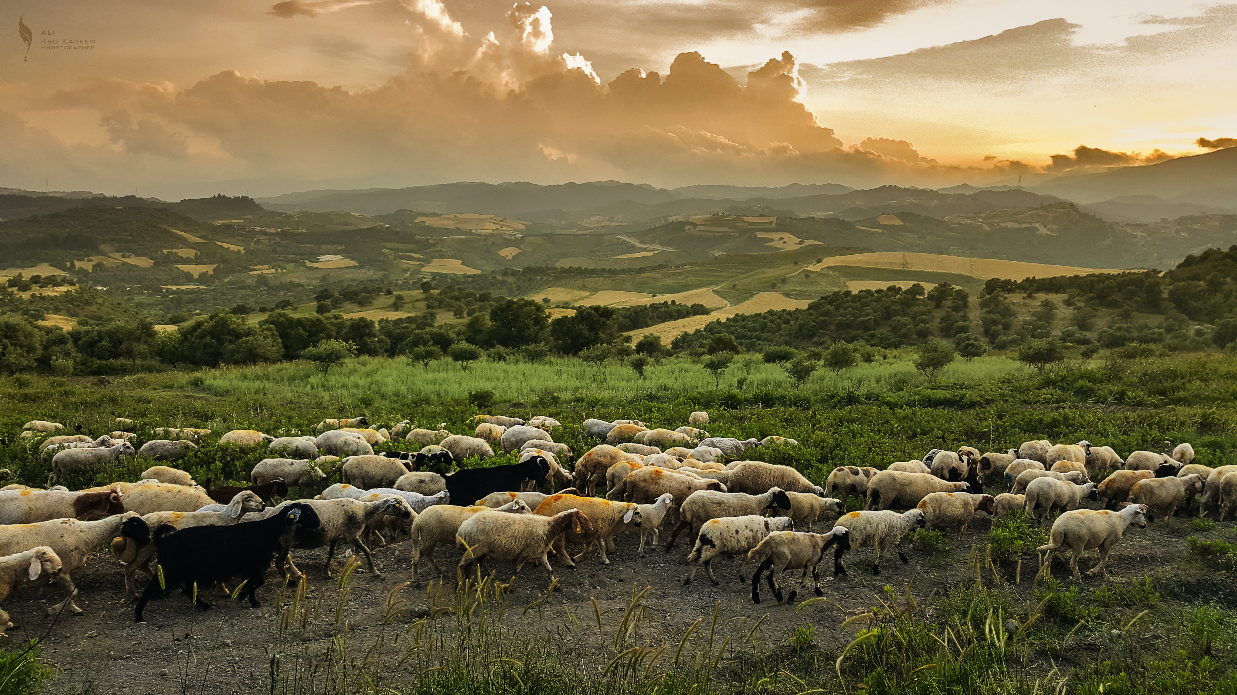
Micah
Message #5
6:1-7:17
As for me, I look to the LORD for help. I wait confidently for God to save me, and my God will certainly hear me.

Slide 2
How does Micah exalt God and point specifically to the Messiah?
What kind of sin, what kind of injustice, is Micah calling out?
How does leadership, and your leadership in particular, affect people?
How is God going to solve Micah’s and the Israelite—and our!—problems?
Micah is about How God responds to unjust Israelite leaders

Slide 3
What does God want?
Micah 6:1-7:17

Slide 4
God wants
us to
Remember
Micah 6:1-6:8

Slide 5
God wants
us to
Fear Him
Micah 6:9-16

Slide 6
God wants
us to
Wait
Micah 7:1-17

Slide 7
What God Wants
Remember
HIM
Fear
Wait on
Micah 6:1-7:17

