Slide 1

Message #1
Overview
Philippians
4:1 Therefore, my brothers, whom I love and long for, my joy and crown, stand firm thus in the Lord, my beloved.
Ever Increasing Joy

Slide 2

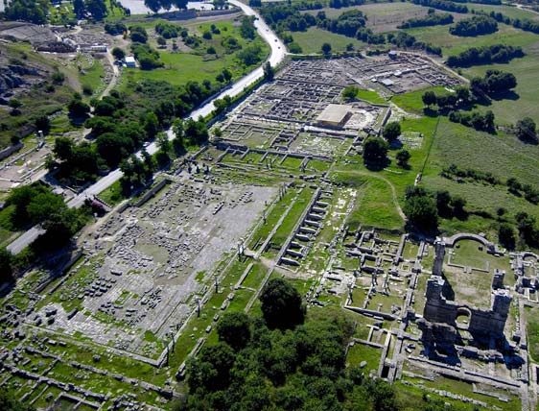
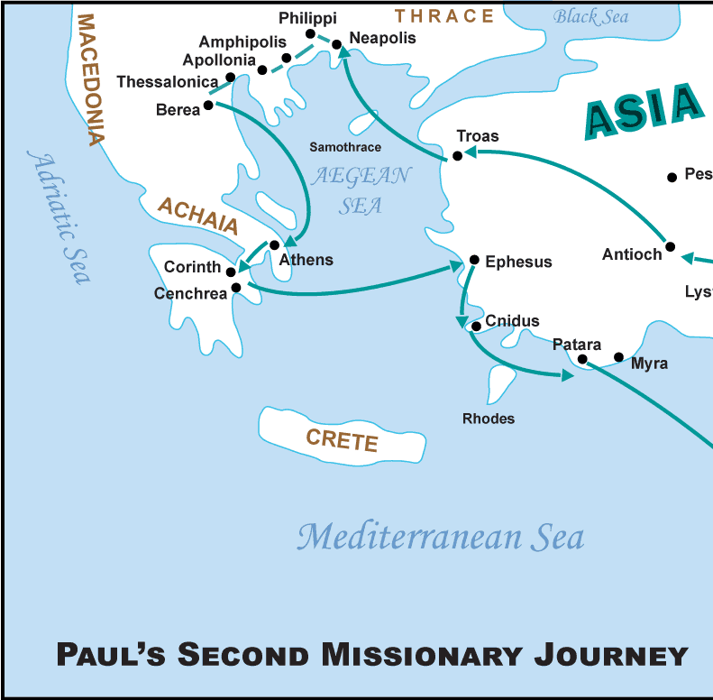
Message #1
Overview
Acts 16:11-15

Slide 3
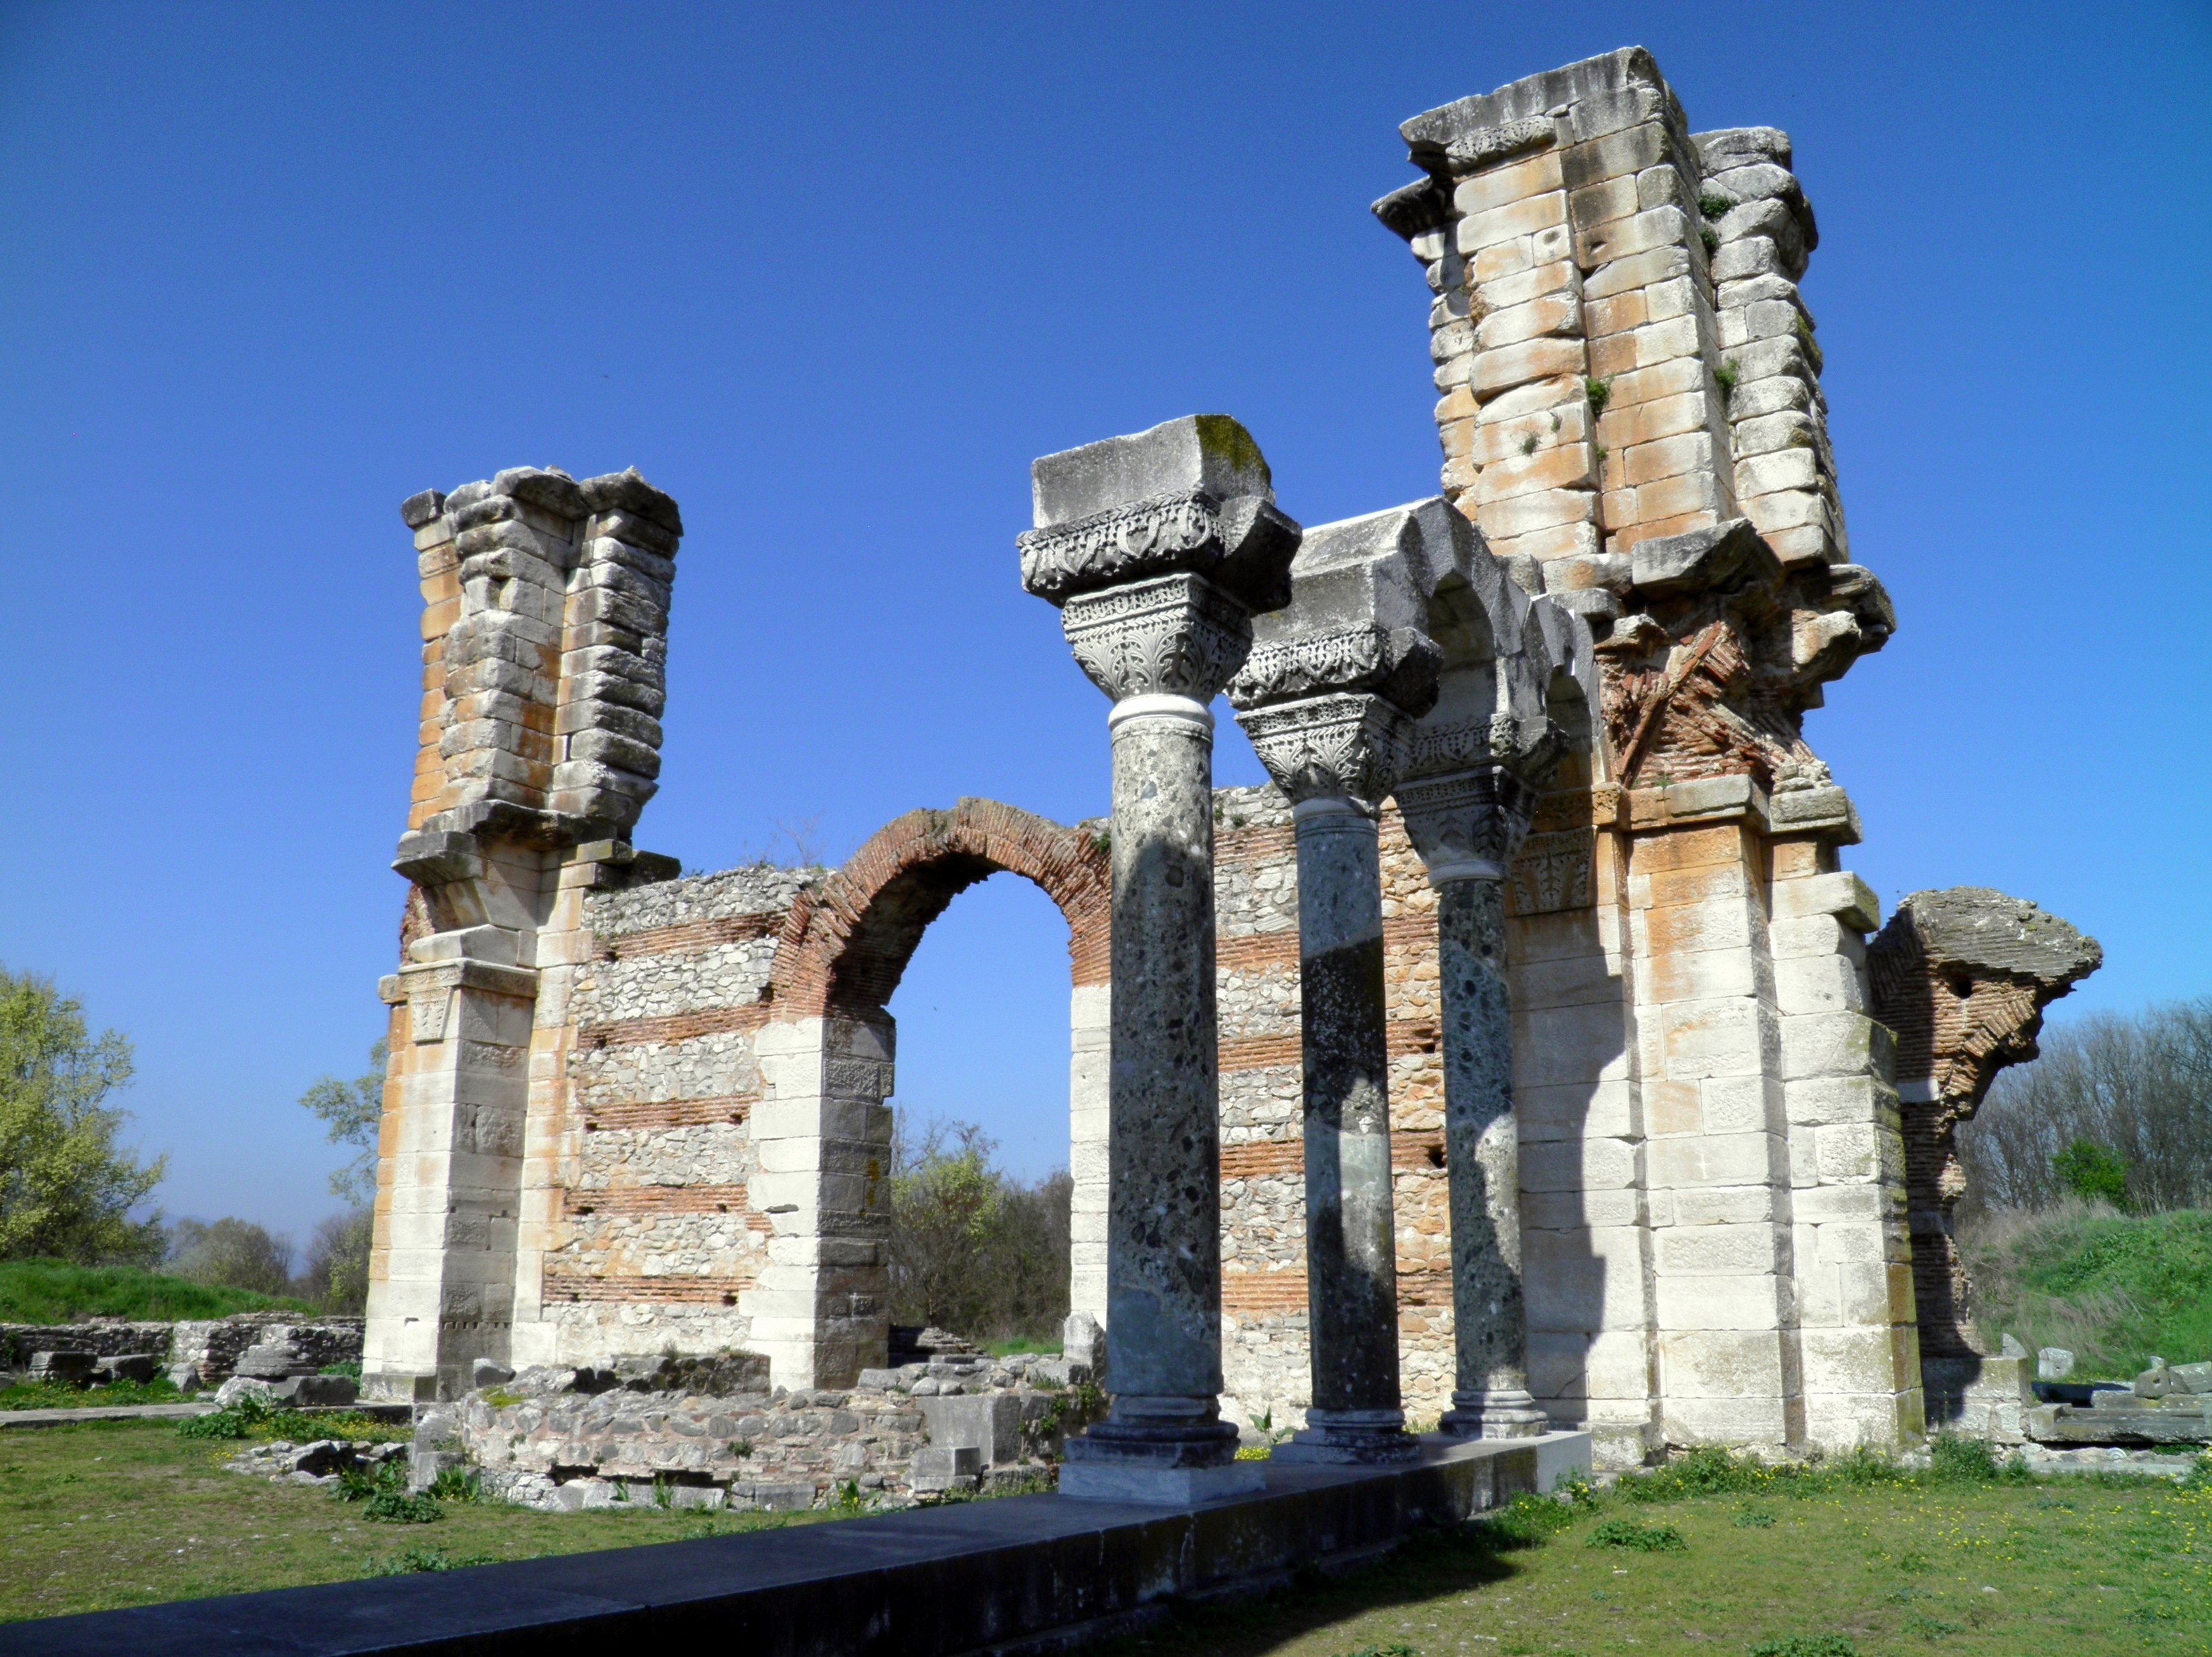
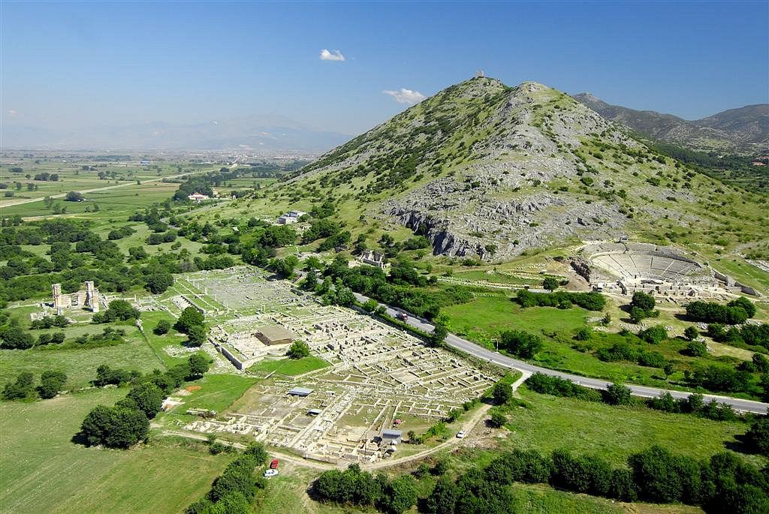
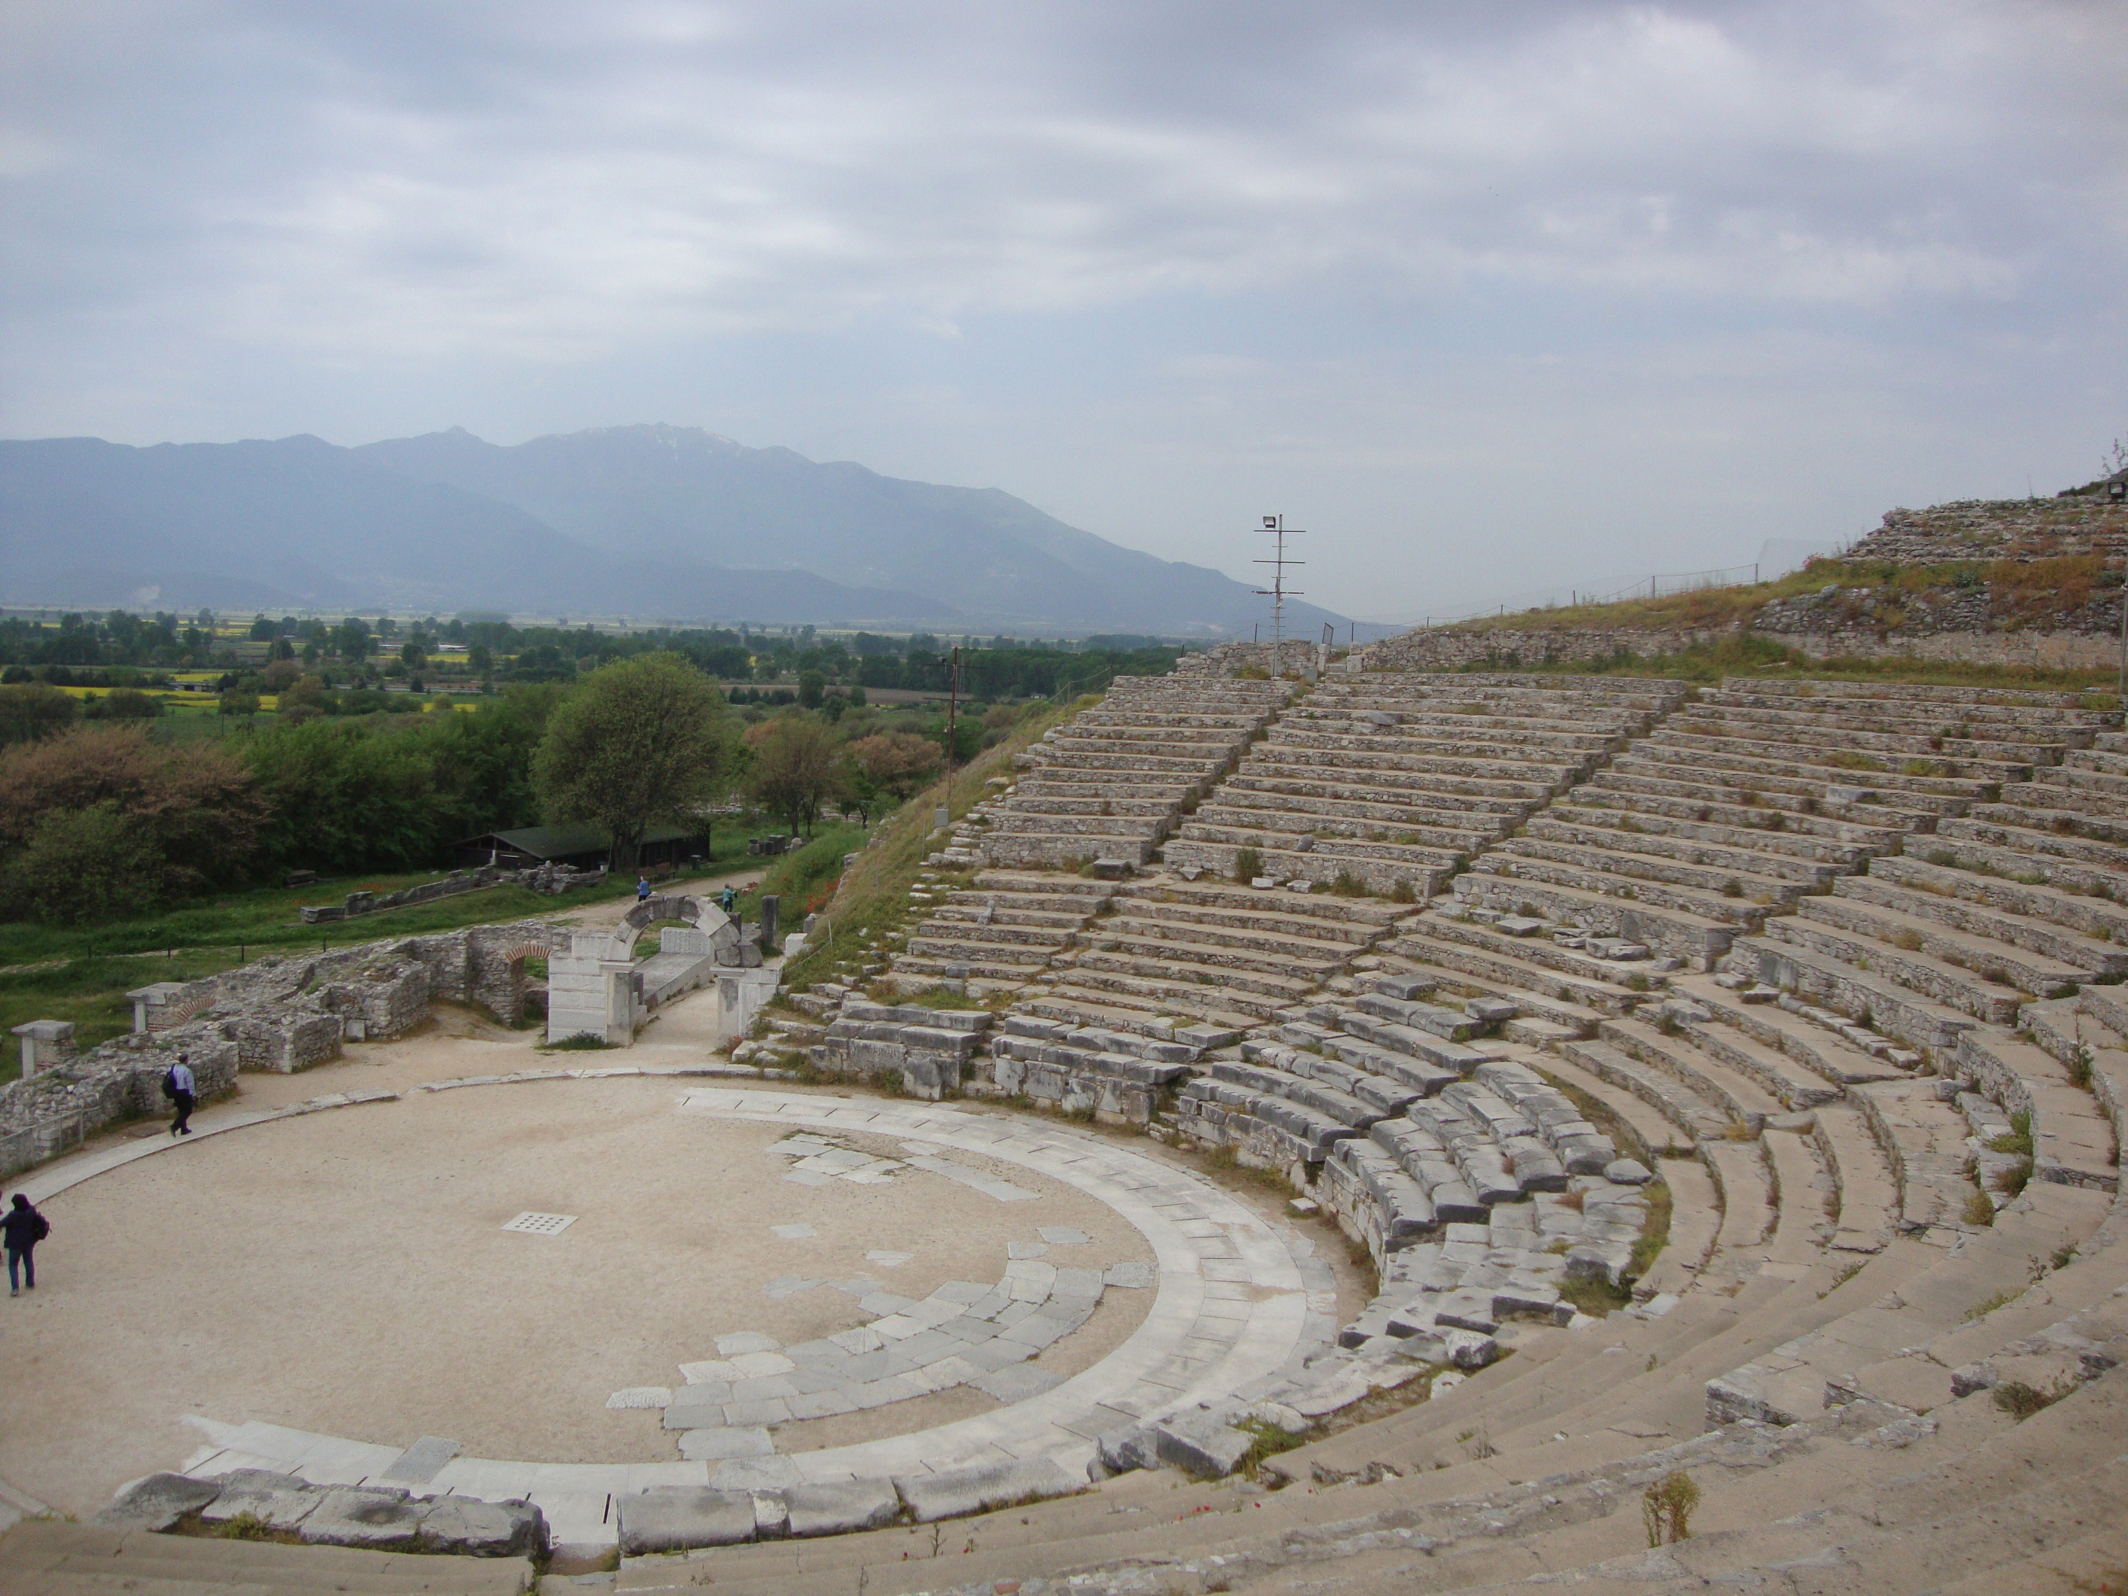
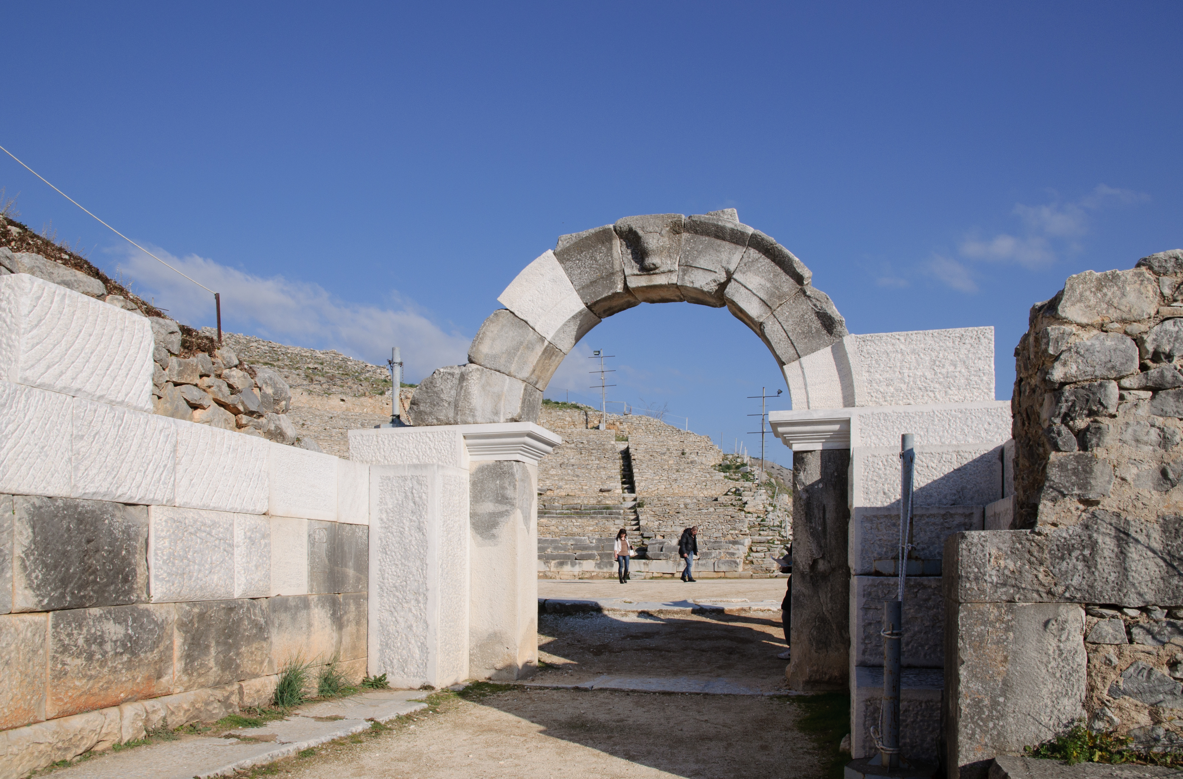
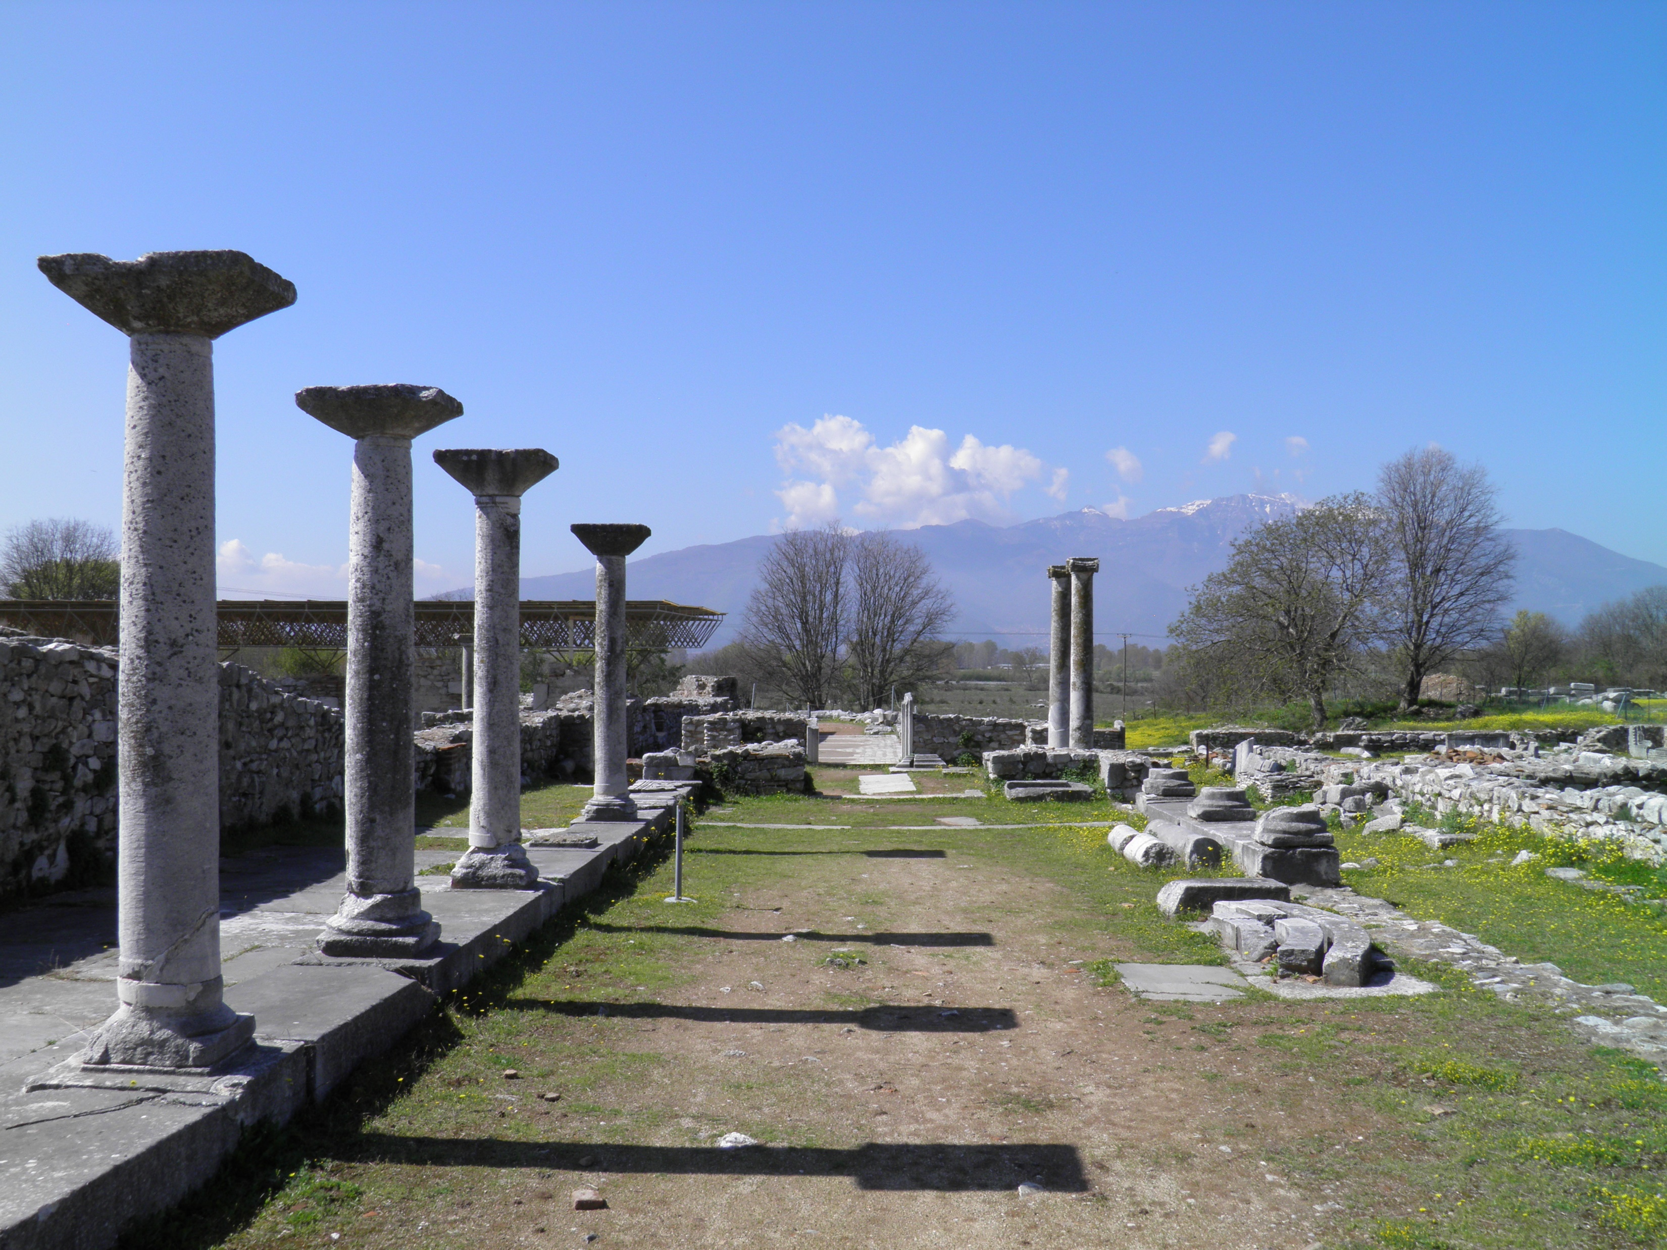
Message #1
Overview
Acts 16:16-21

Slide 4
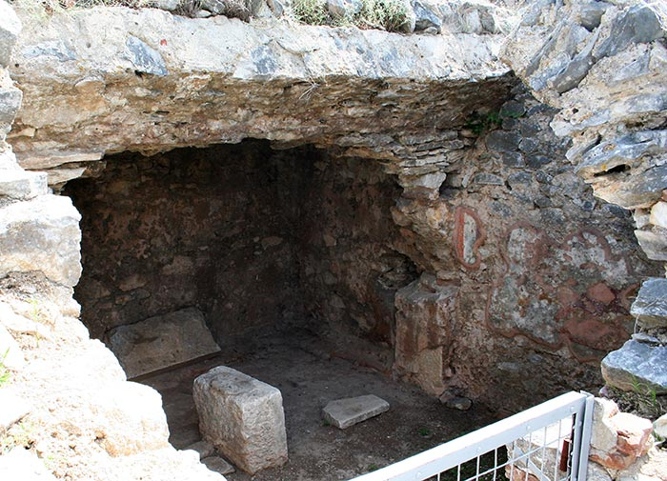
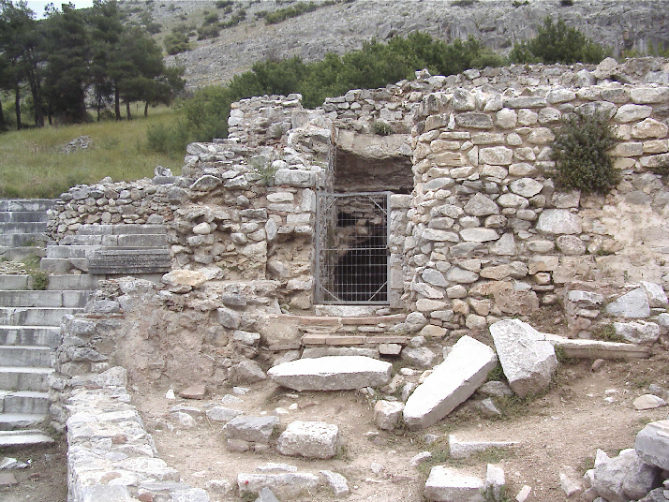
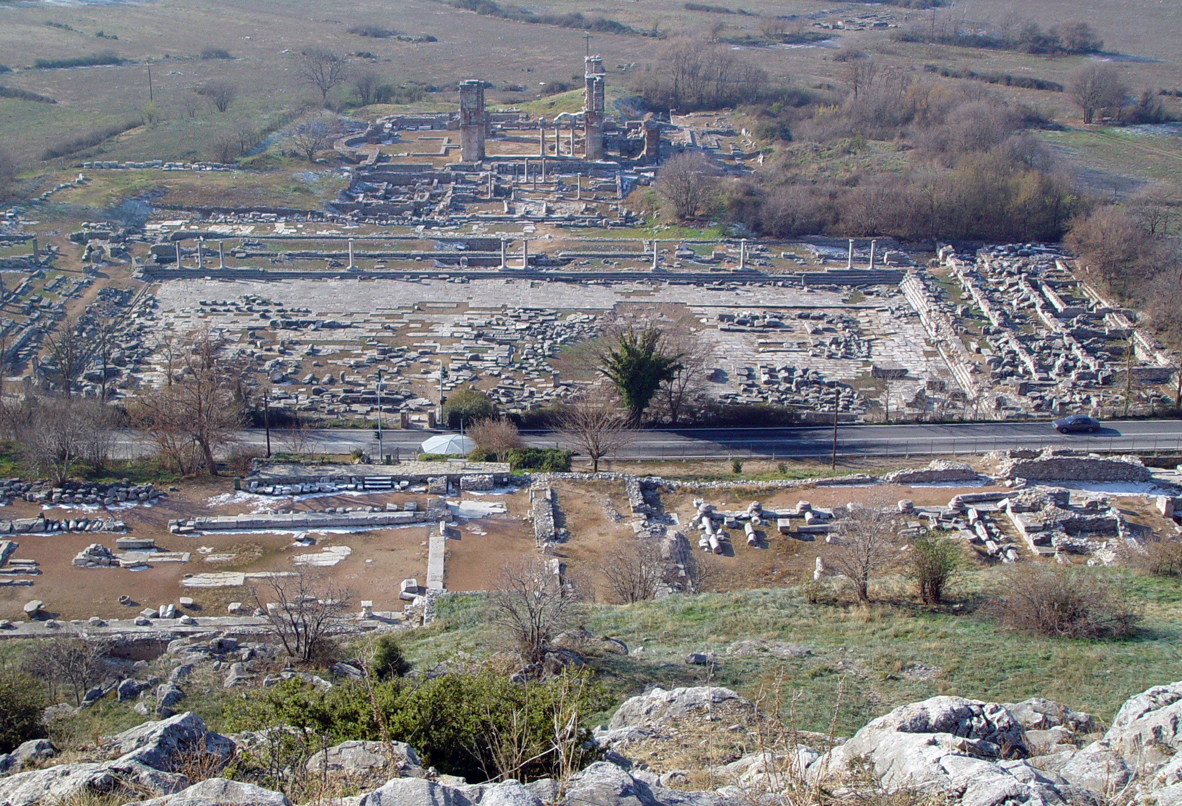
Message #1
Overview
Acts 16:22-40

Slide 5
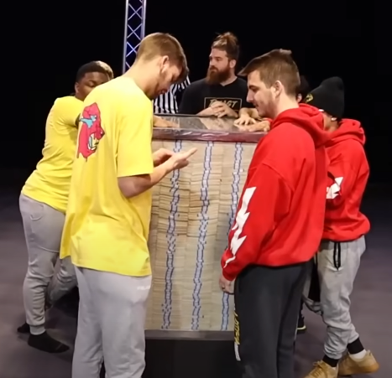
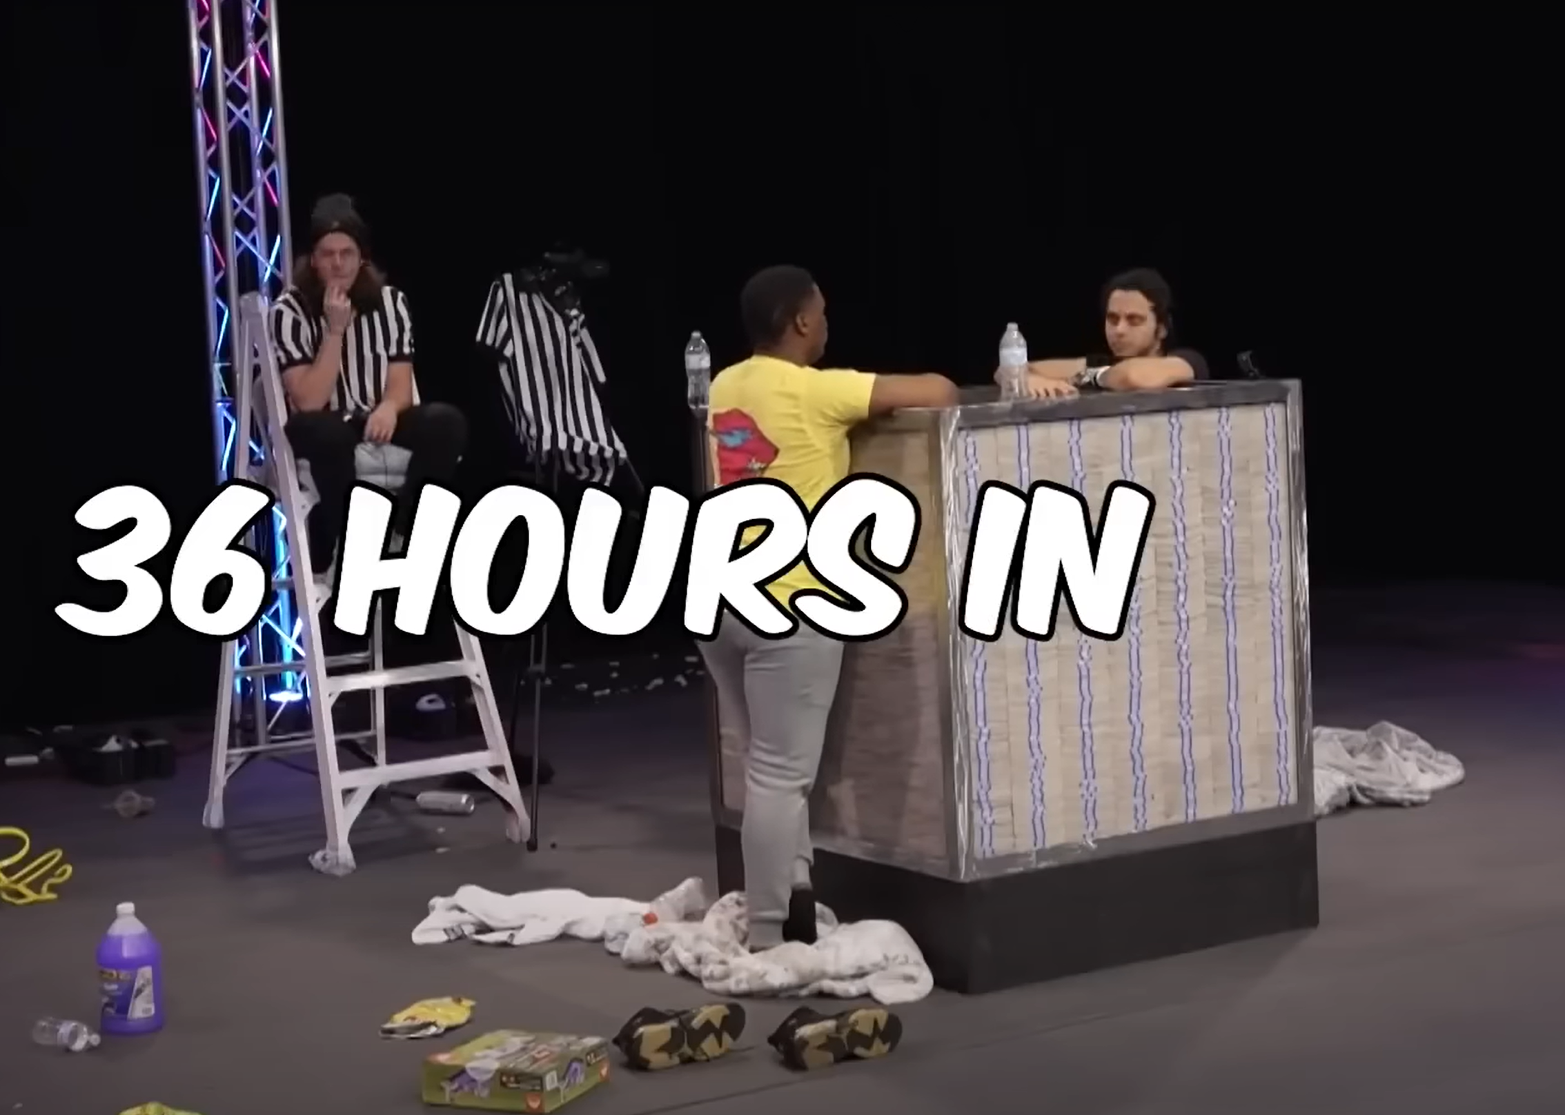
Message #1
Overview
How can the entire church at Philippi continue to stand firm?

Slide 6
How can the entire church at Philippi continue to stand firm?
Message #1
Overview
Chapter 1: The Philippians would stand firm if they rejoiced in the advance of the gospel no matter what.
Chapter 2: The Philippians would stand firm if they followed the pattern of joyful humility set out by others.
Chapter 3: The Philippians would stand firm if they really, deeply and personally experience the joy of knowing Christ.
Chapter 4: The Philippians would stand firm if they rejoiced in God’s provision.

Slide 7

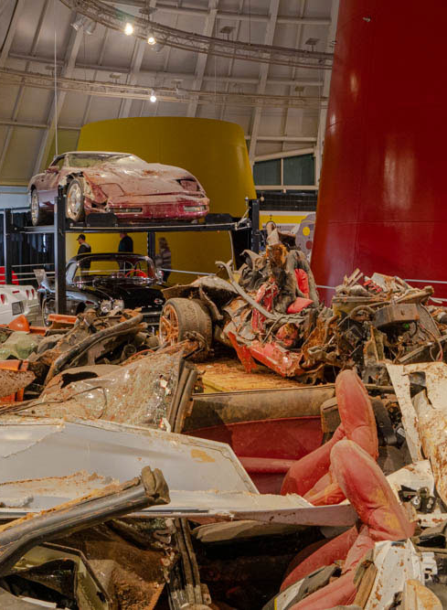


Message #1
Overview
How can the entire church at Philippi continue to STAND FIRM?

Slide 8
Key Verses
Message #1
Overview
1:27
... I may hear of you that you are standing firm in one spirit, with one mind striving side by side for the faith of the gospel.
2:3
Do nothing from selfish ambition or conceit, but in humility count others more significant than yourselves.
3:8
Indeed, I count everything as a loss because of the surpassing worth of knowing Christ Jesus my Lord…
4:1
Therefore, my brothers, whom I love and long for, my joy and crown, stand firm thus in the Lord, my beloved.
4:19
And my God will supply every need of yours according to his riches in glory in Christ Jesus.

Slide 9
Major Themes
Message #1
Overview
Providence— What is behind all that happens in life?
Value of Christ—How much is He worth?
Joy—How do I get it? Where does it come from? Why is it so important!
Humility—Is God humble? How can I be more humble?
Unity—How do we get along with other people?
Peace—How can I live at peace in difficult circumstances?

Slide 10
Catch Phrases
Message #1
Overview
Joy from Progress
Unity from Humility
Christ above All

